Slide 1
PEOPLE FALL DETECTION
21PT13 - Manish M

Slide 2
CONTENT
Problem statement
Libraries used
Input / Output
Process
Preprocessing
Detection / Classification
Post Processing
Challenges faced
Possible Approaches
Conclusion

Slide 3
Problem Statement
The occurrence of people falling poses a significant risk, with potentially life-threatening consequences. We require a solution capable of accurately identifying falls in various contexts, particularly in hazardous locations such as staircases, escalators, and steps, to ensure the safety and well-being of individuals.

Slide 4
Libraries Used :
Ultralytics ( Yolo model )
Os
Cv2
cvzone

Slide 5
Input/Output :
Input :
Video ( .mp4 )
https://universe.roboflow.com/roboflow-universe-projects/fall-detection-ca3o8/dataset/4
Output :
Trained model evaluation metrics ( confusion matrix, F1 curve, labels, P/PR/R curve, results)
Predicted output_video ( .mp4 )

Slide 6
Preprocessing
Extracts frames from a video file.
Uses OpenCV's VideoCapture to read the video file.
Saves frames as individual image files.
Creates an output directory if it doesn't exist.
Iterates through the video frames until no more frames can be read.
Tracks the number of frames processed using a counter variable.

Slide 7
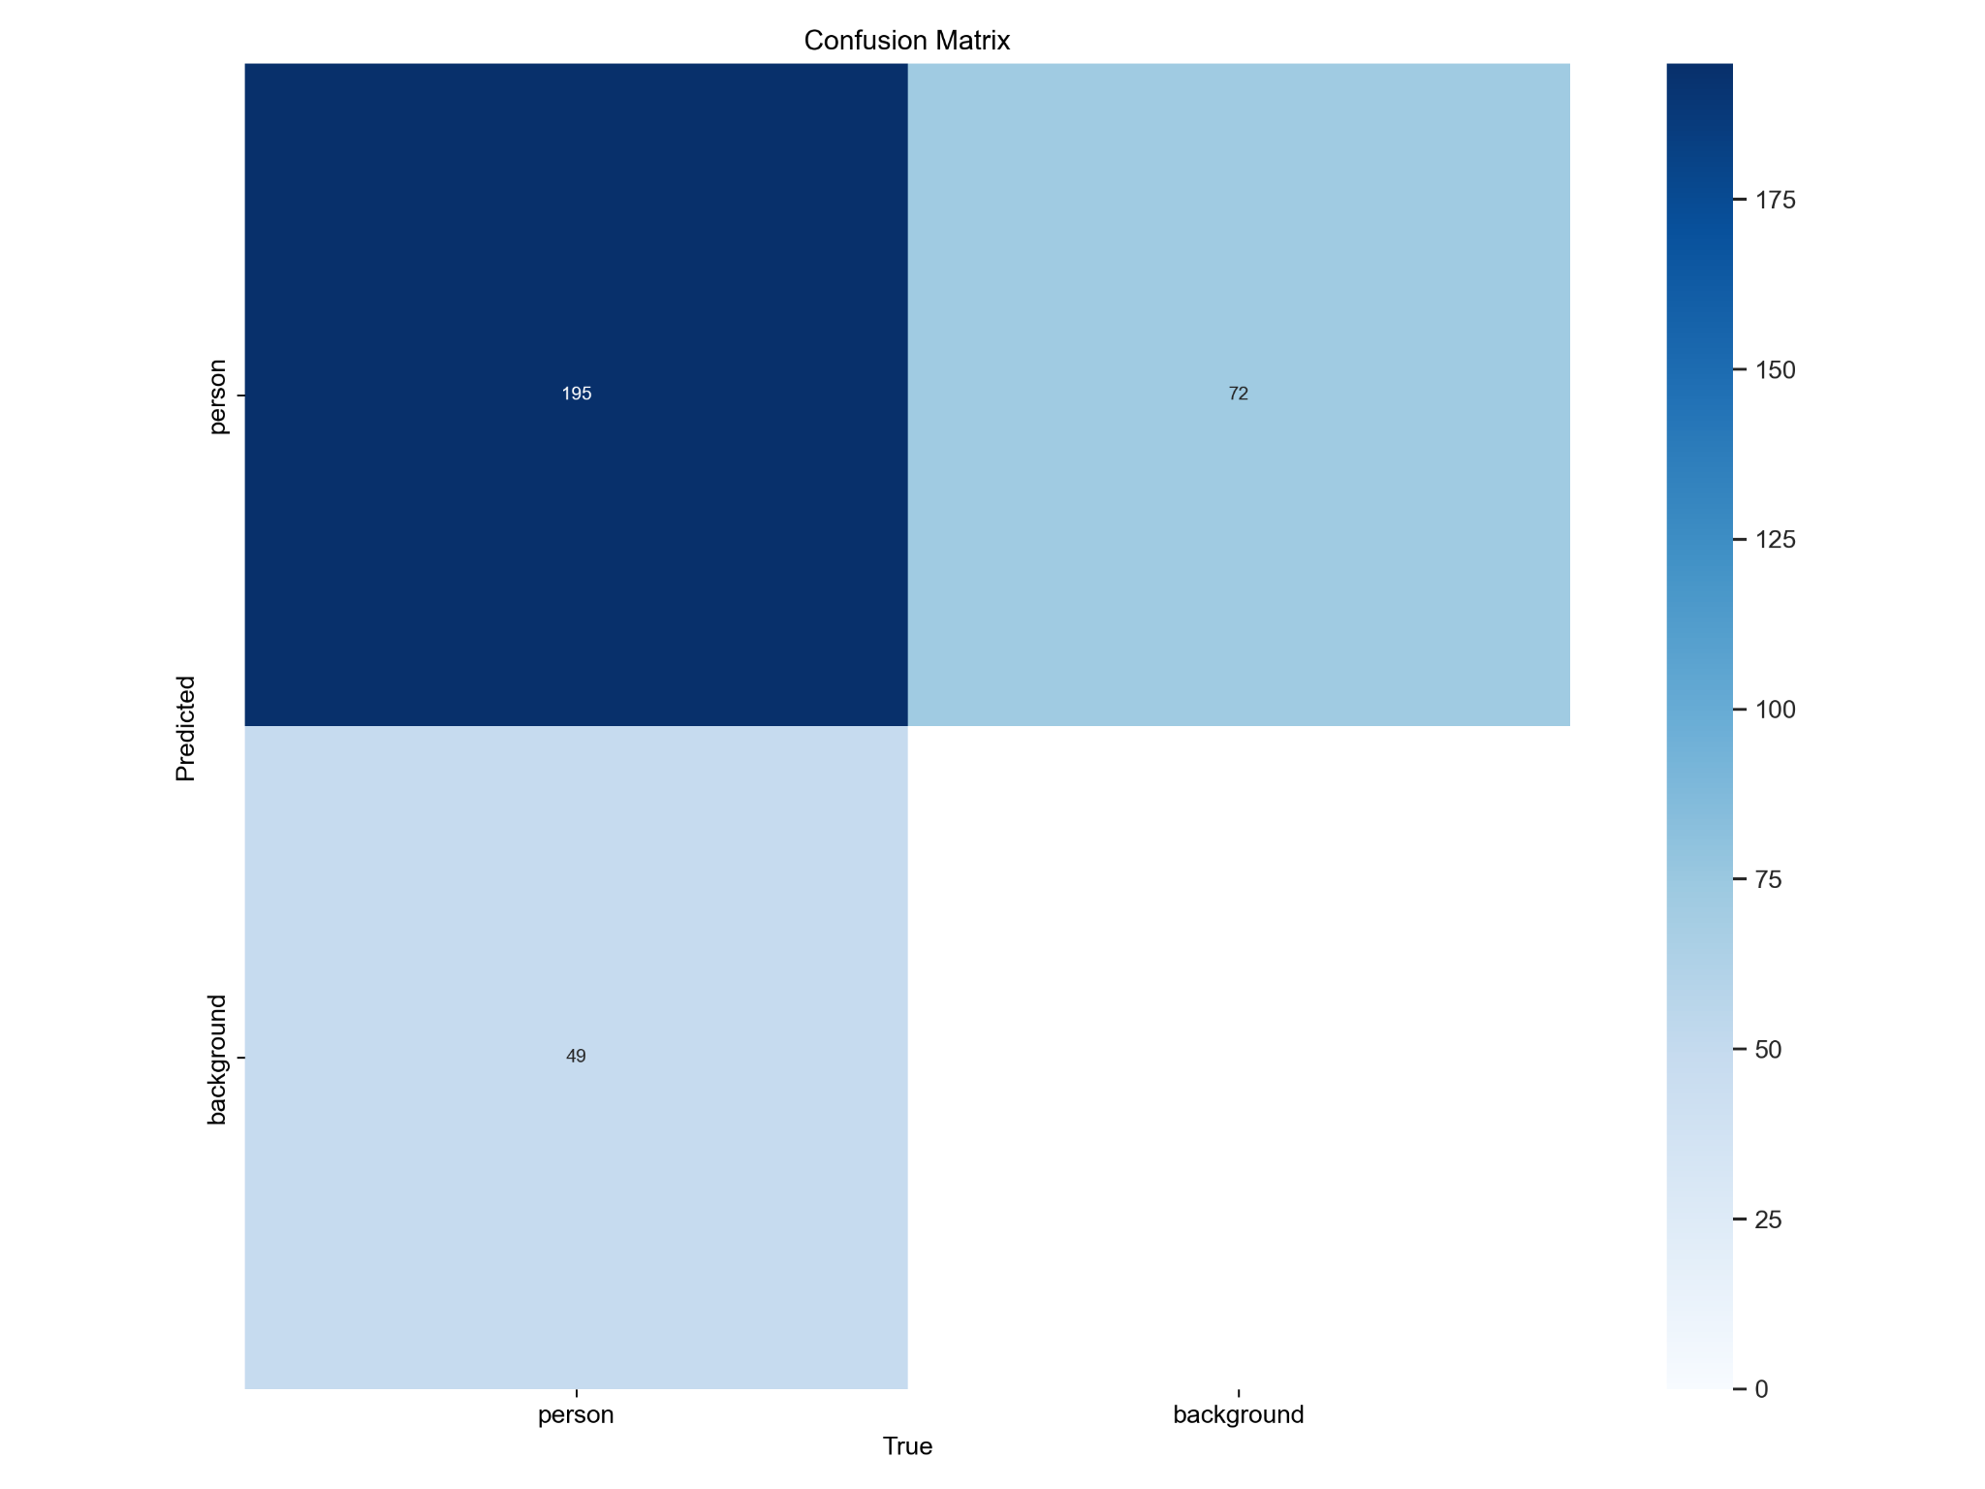
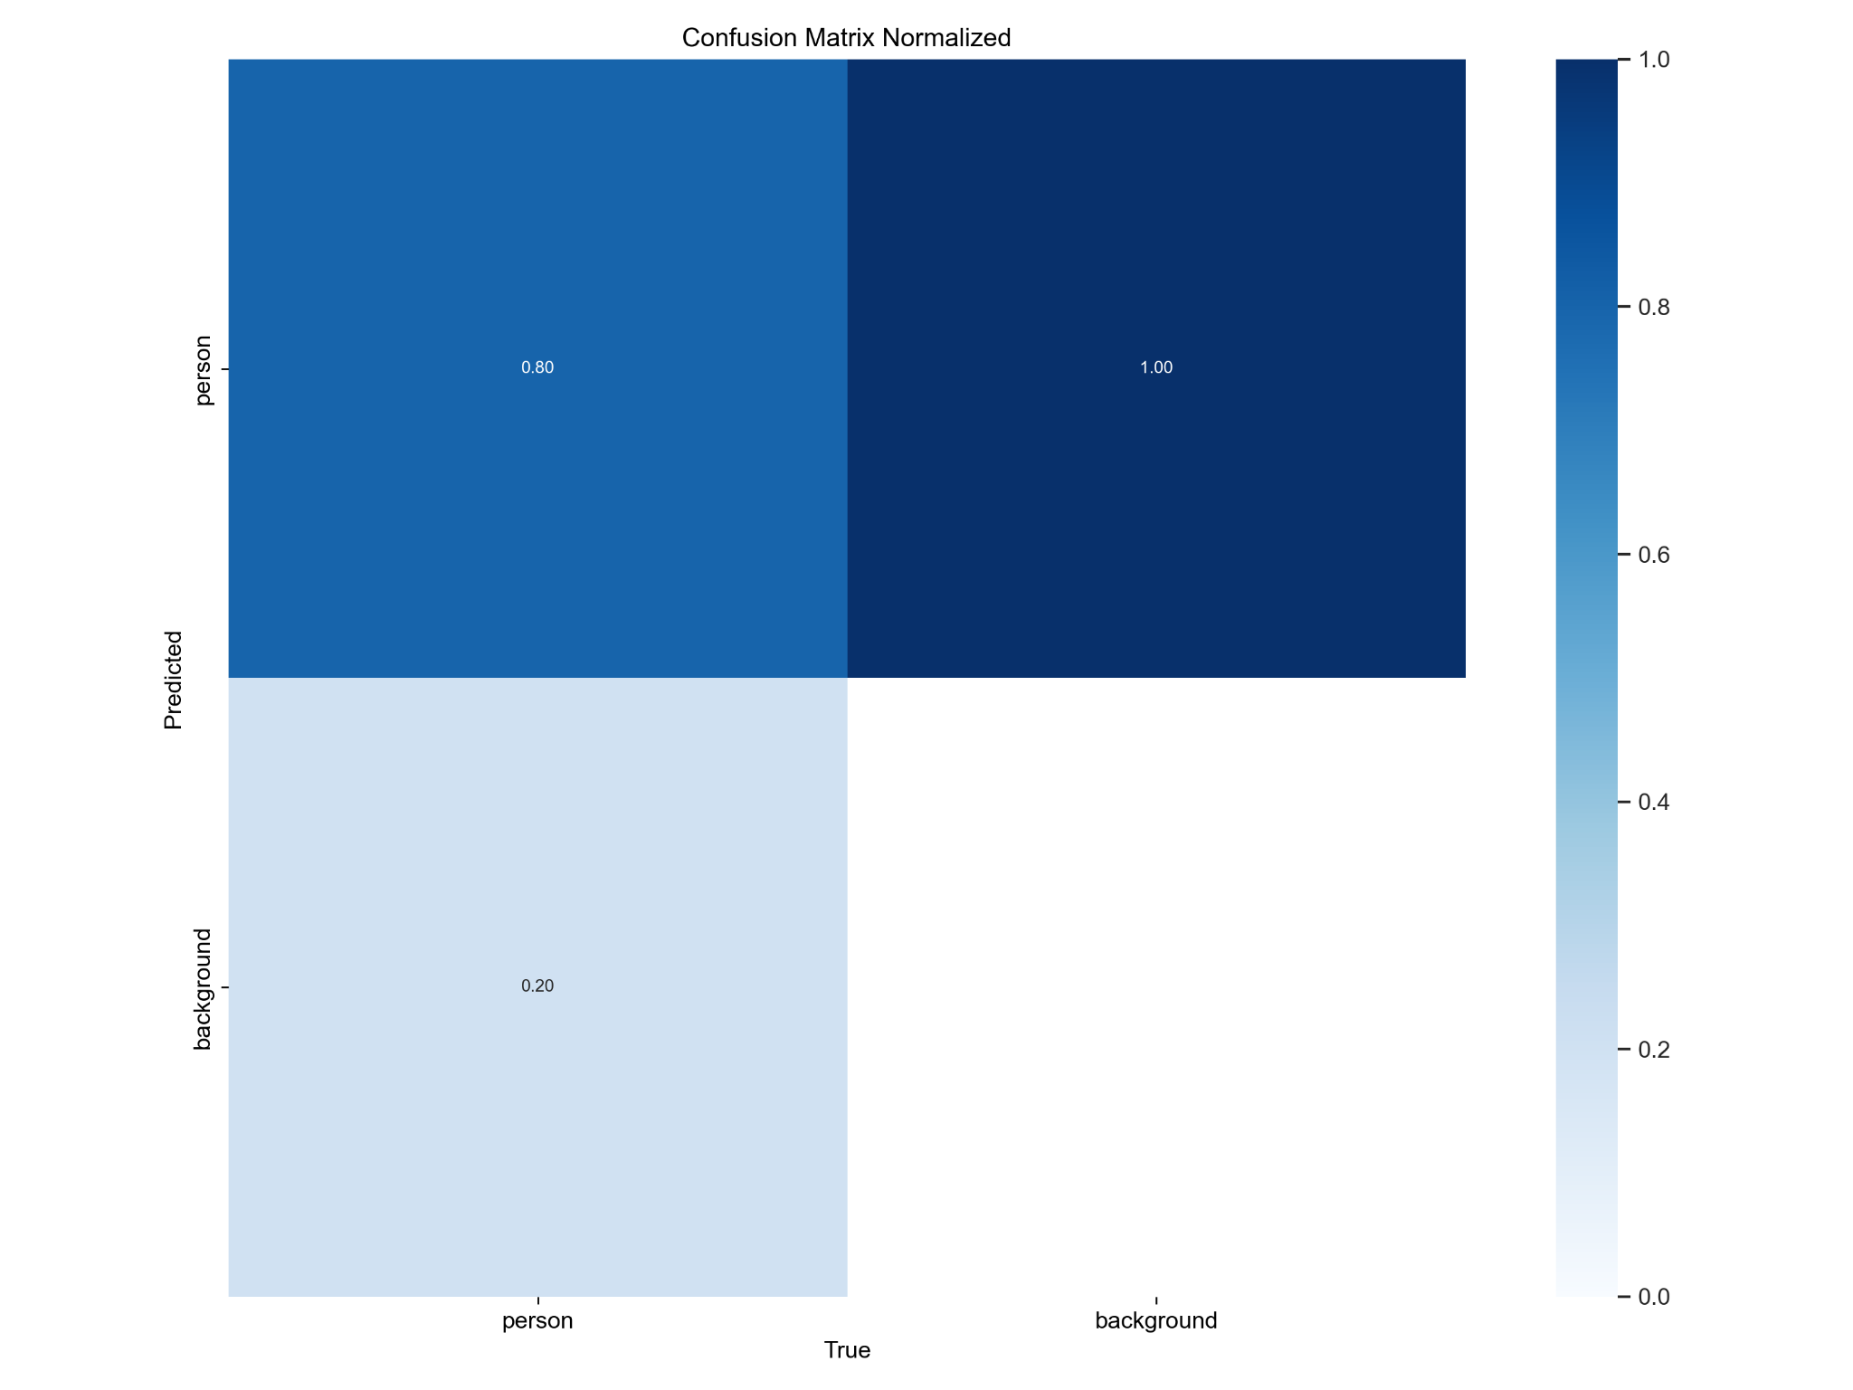
Training Phase
Confusion Matrix :

Slide 8
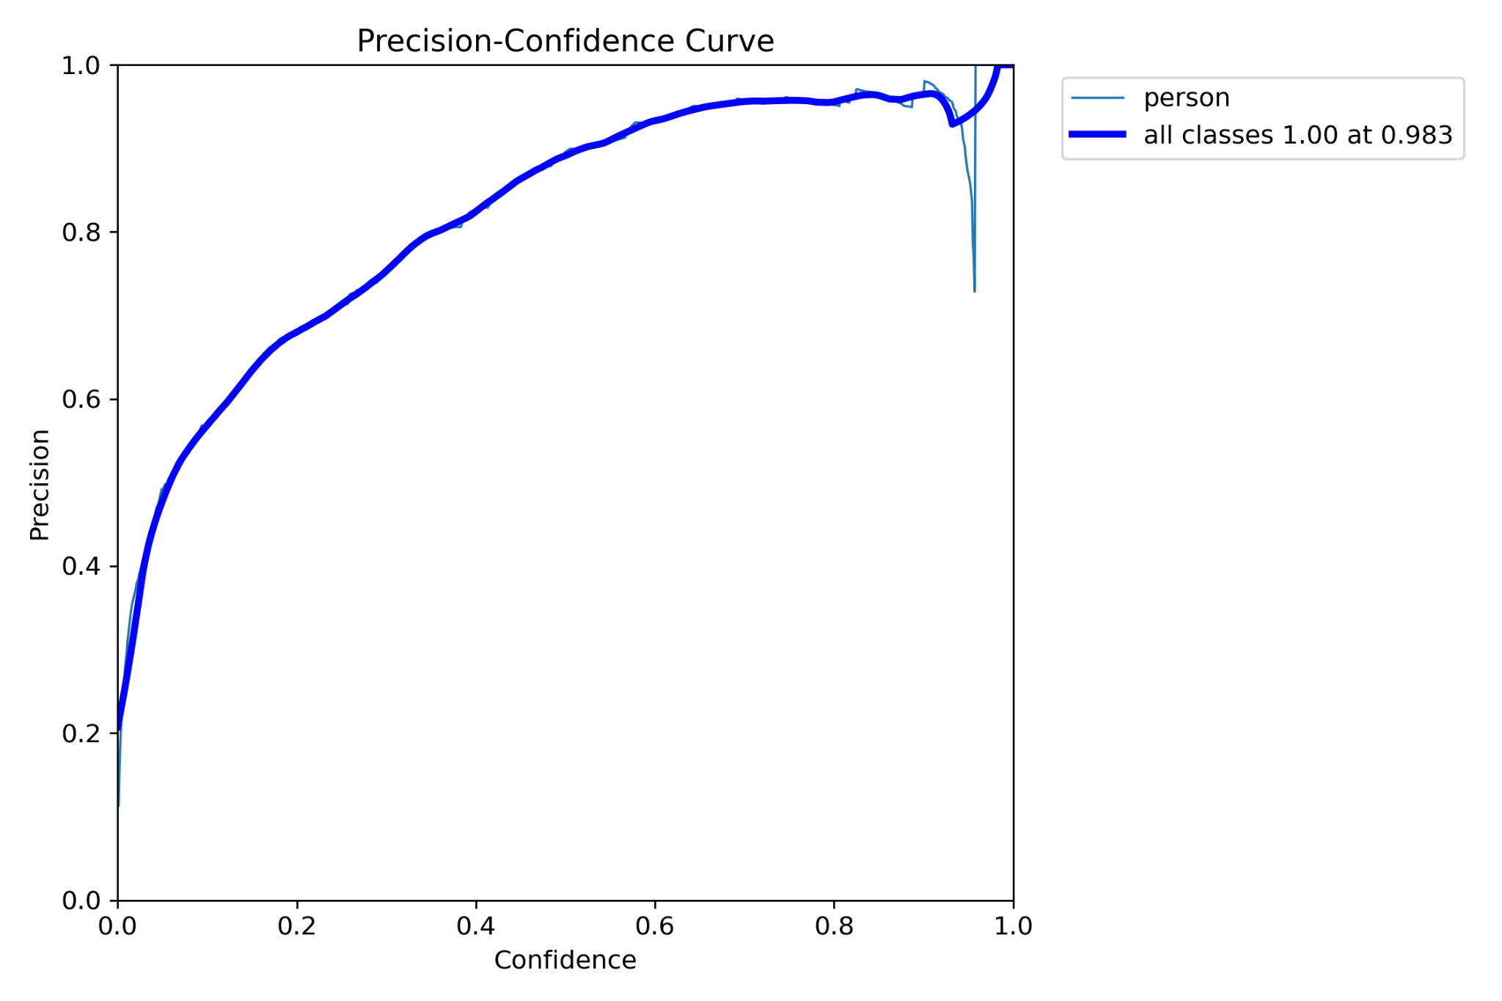
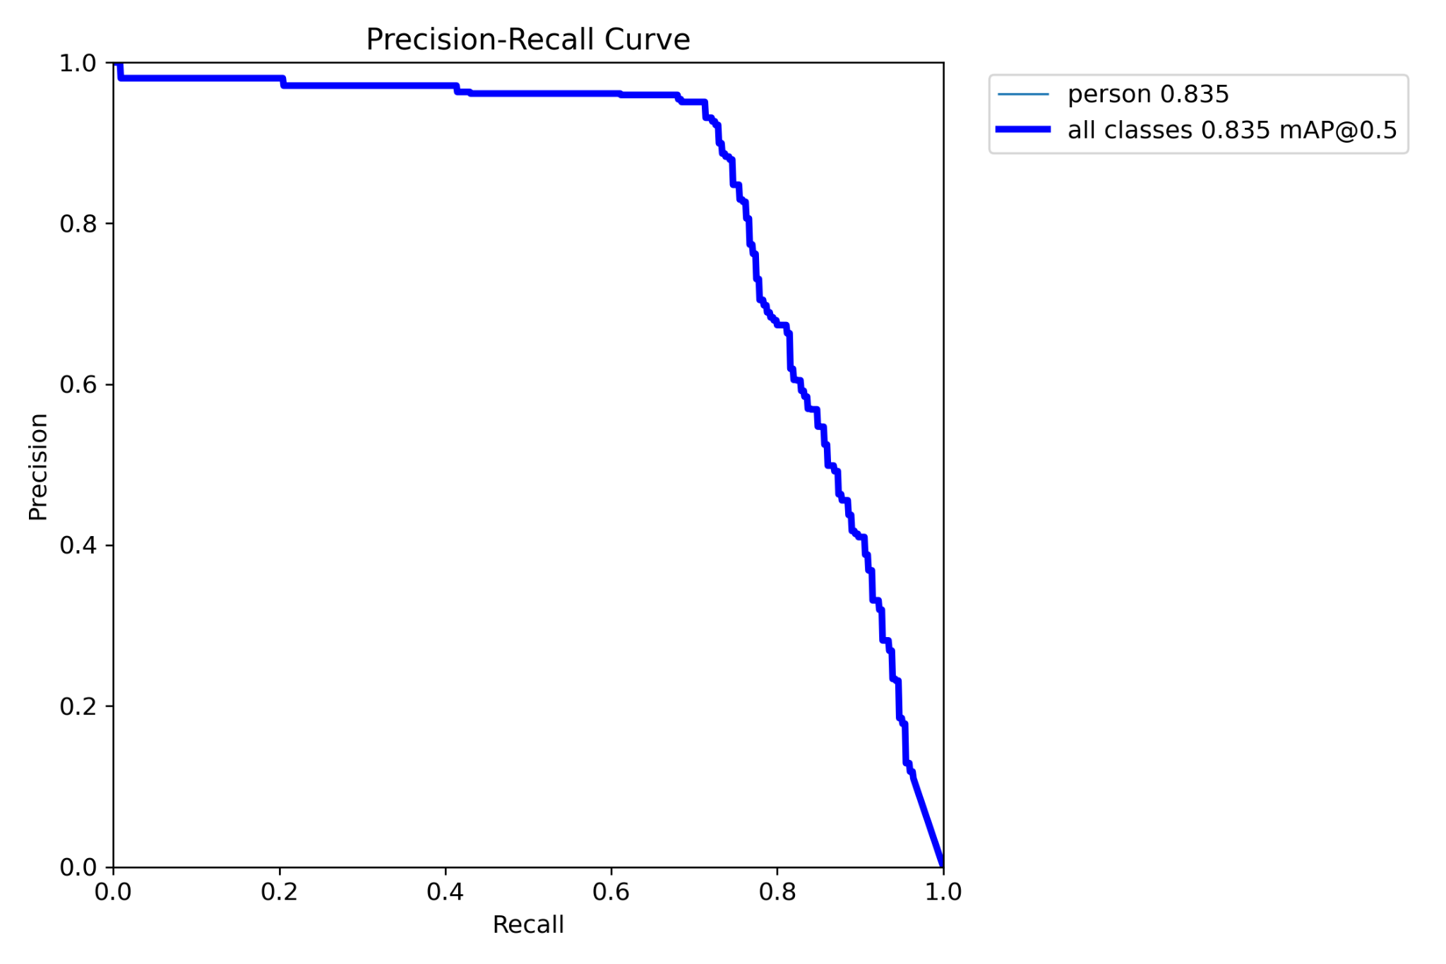
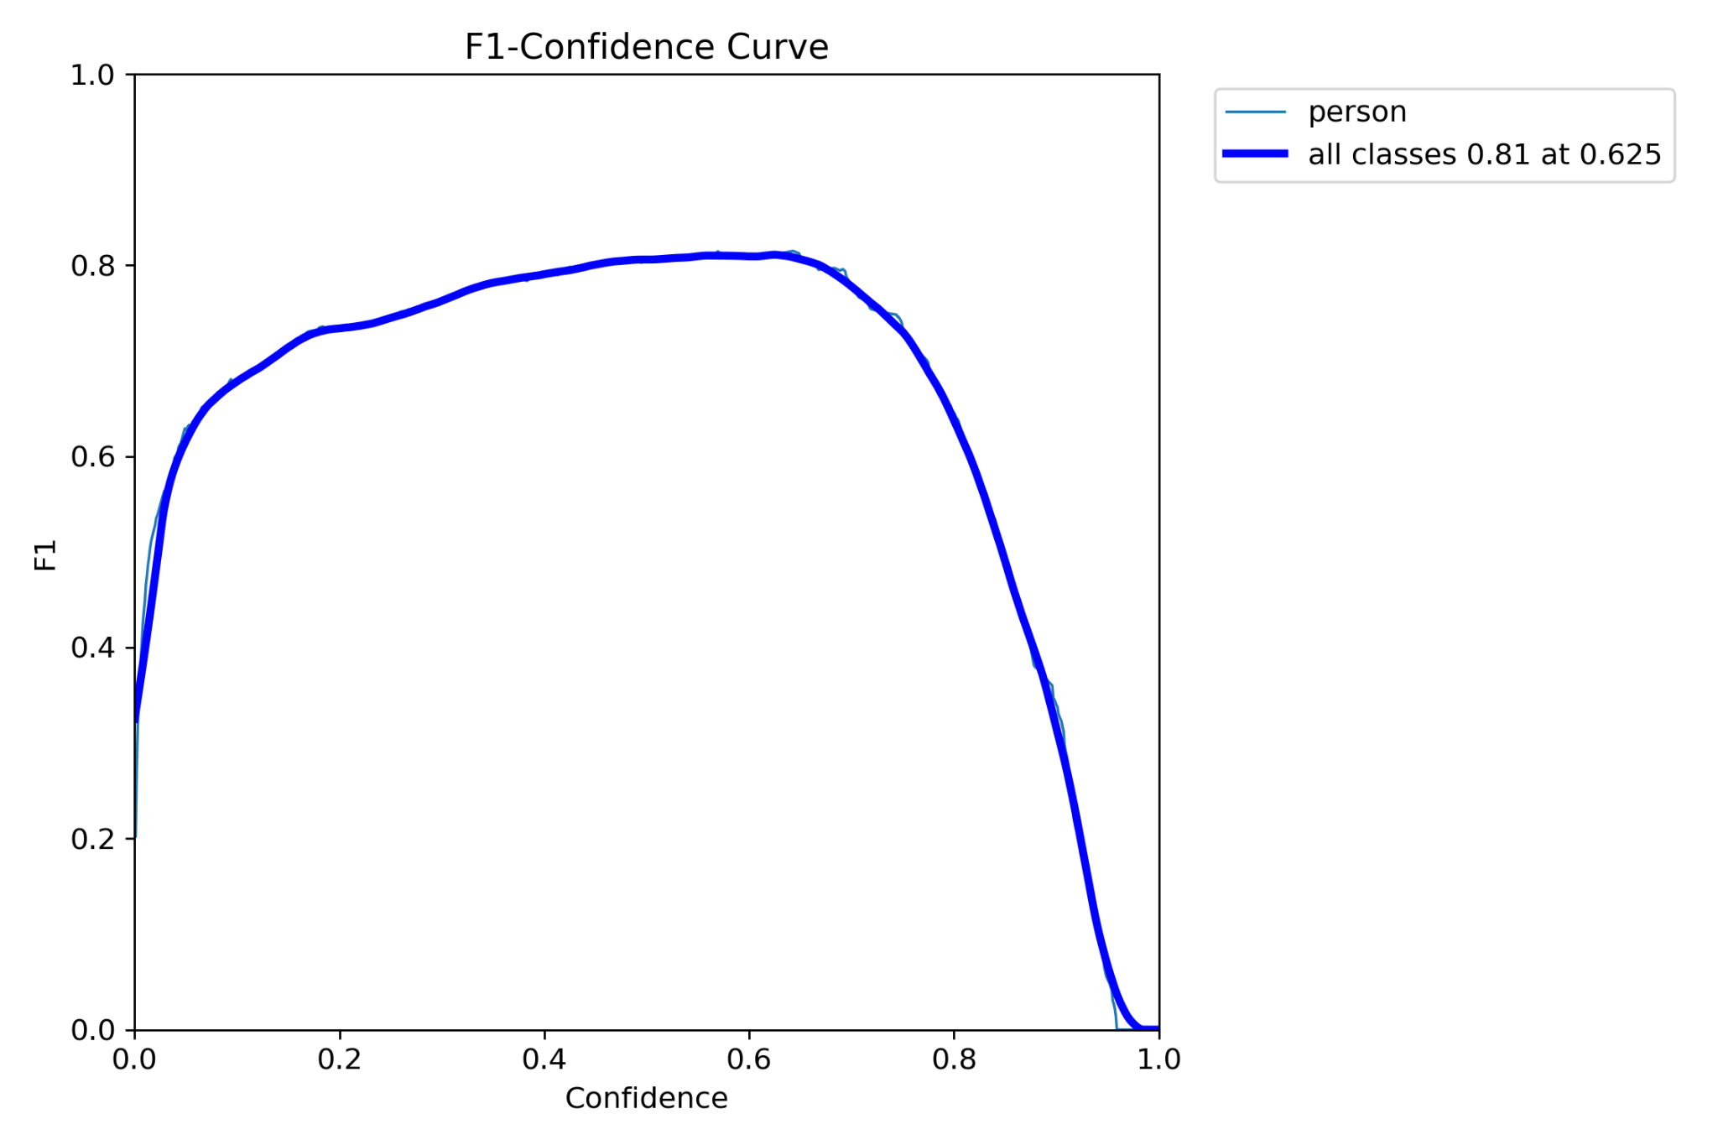
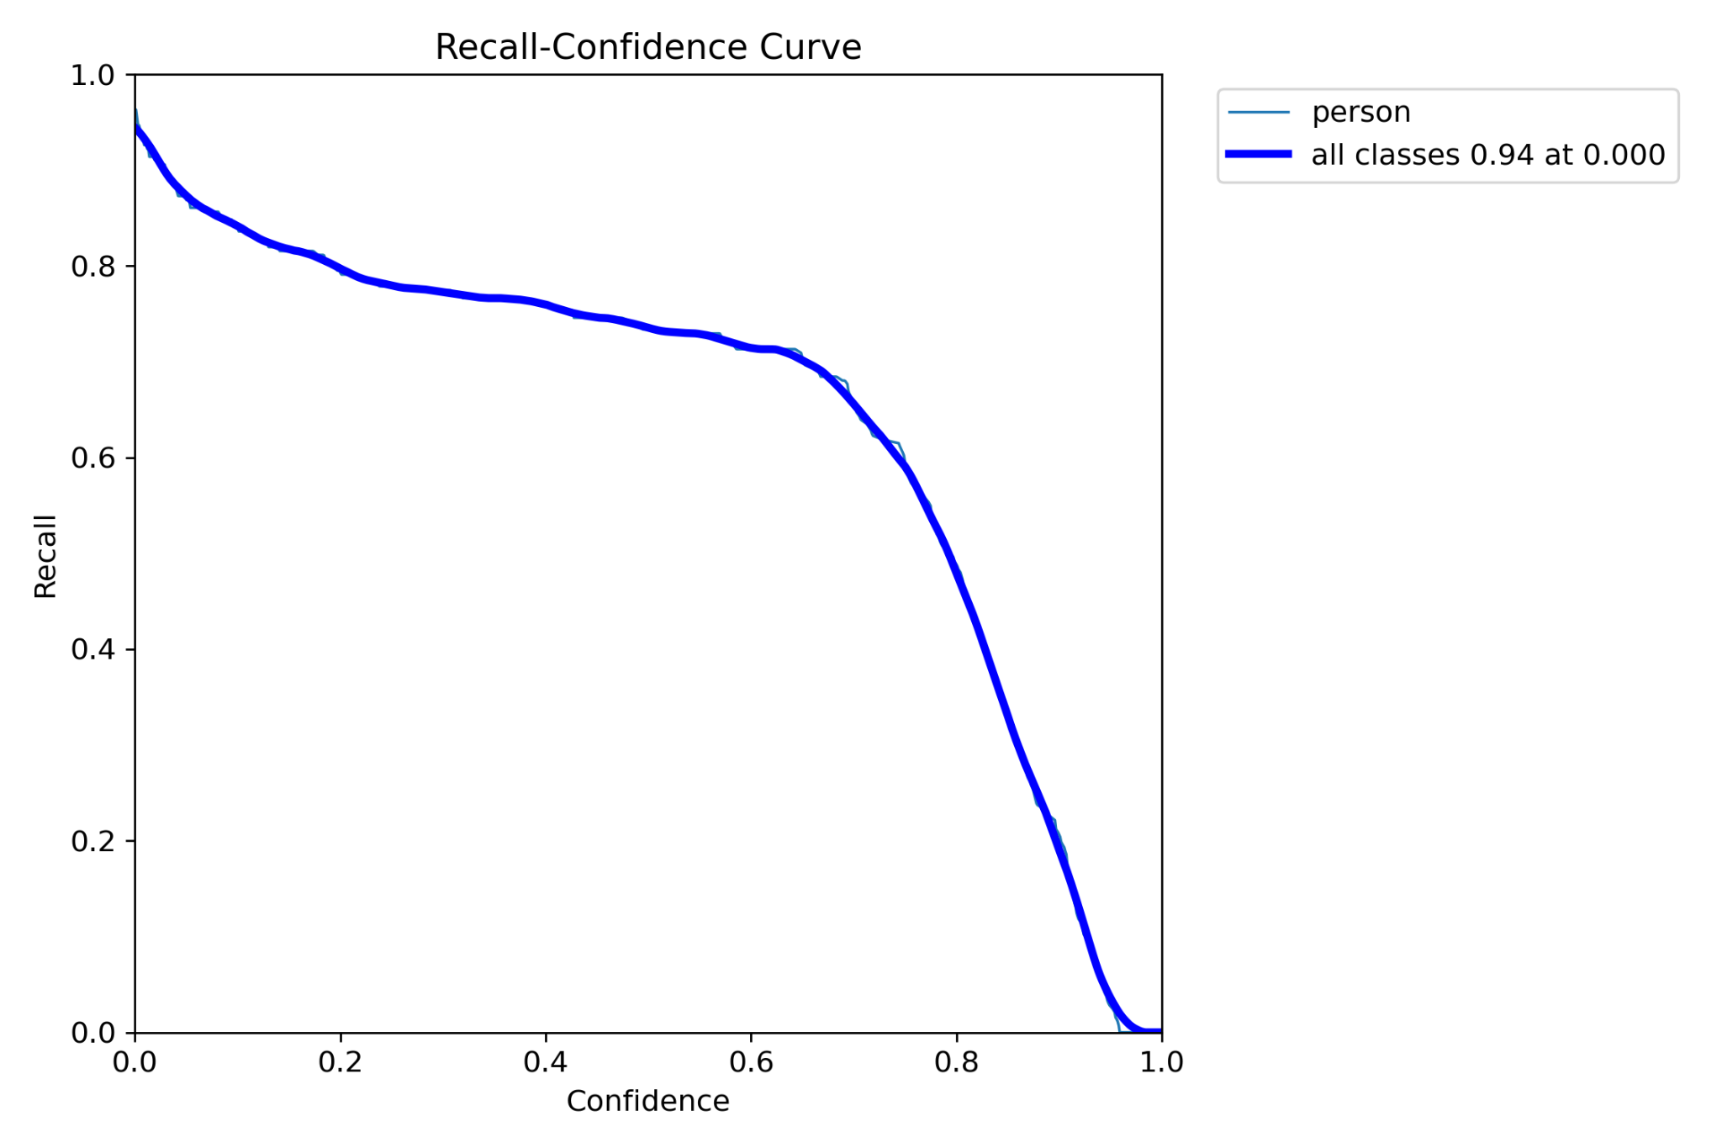
Training Phase
F1/P/PR/R curve

Slide 9
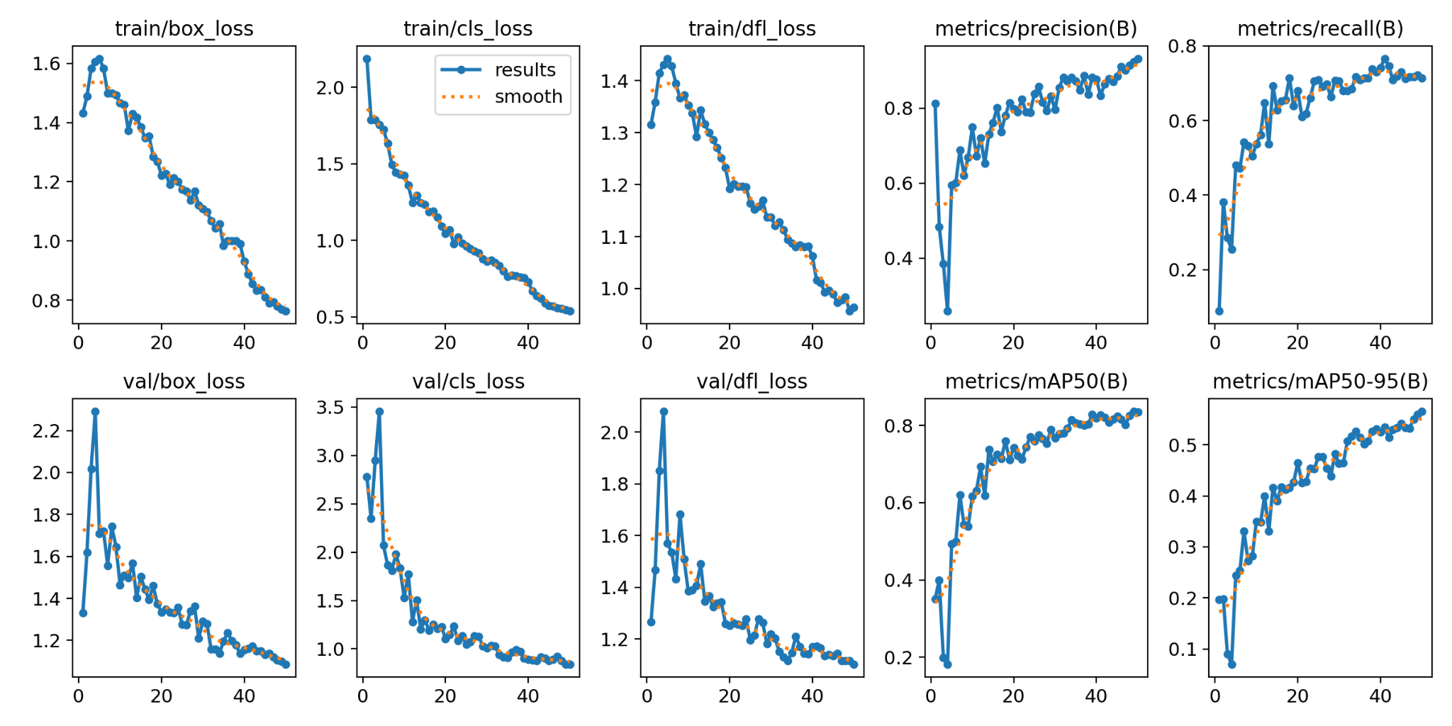
Training Phase
Result :

Slide 10
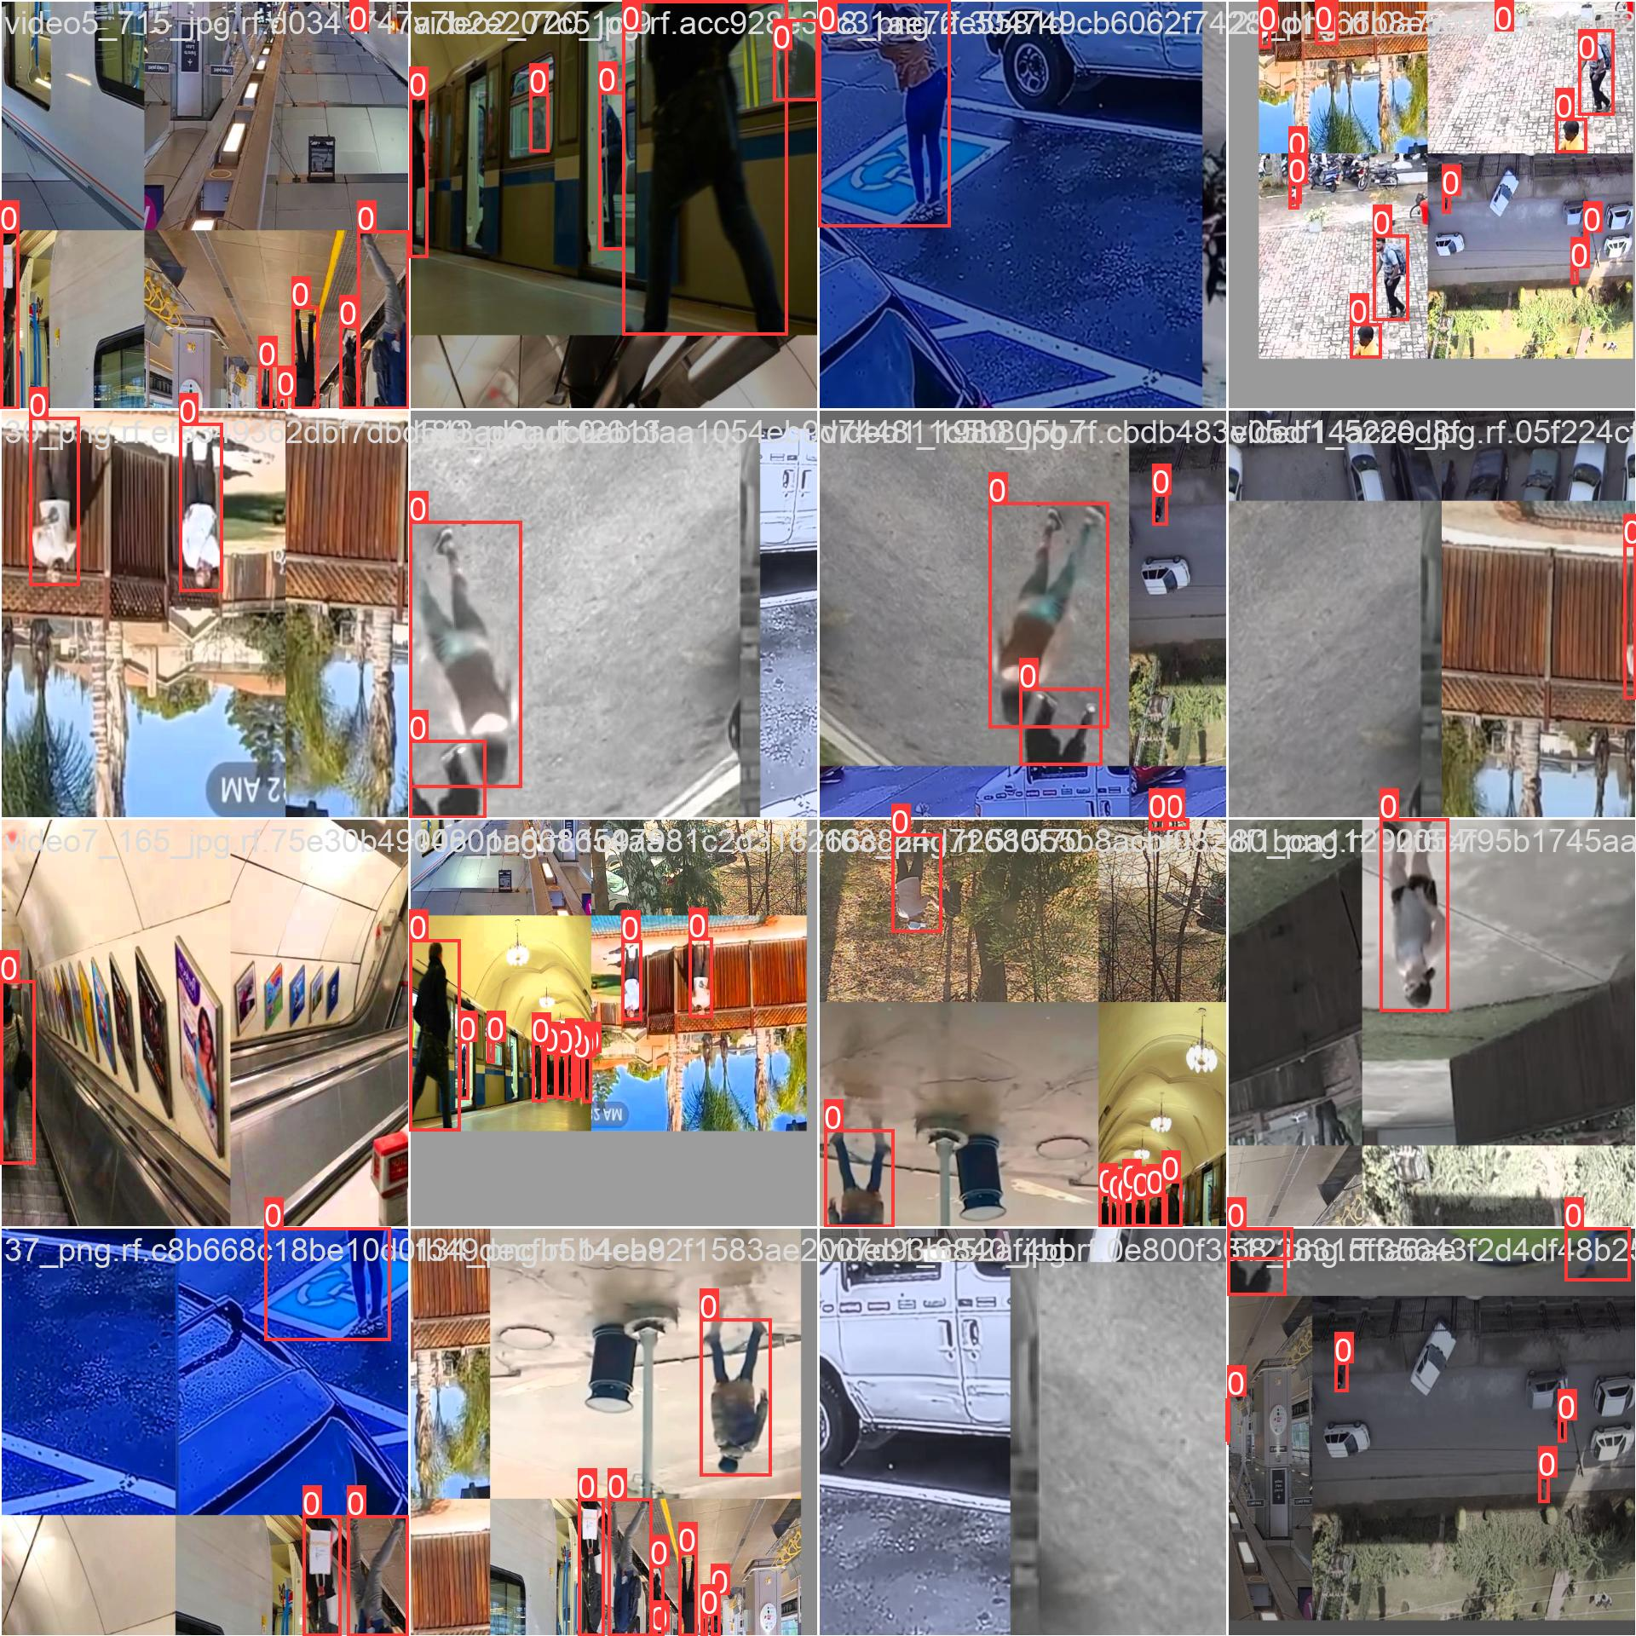
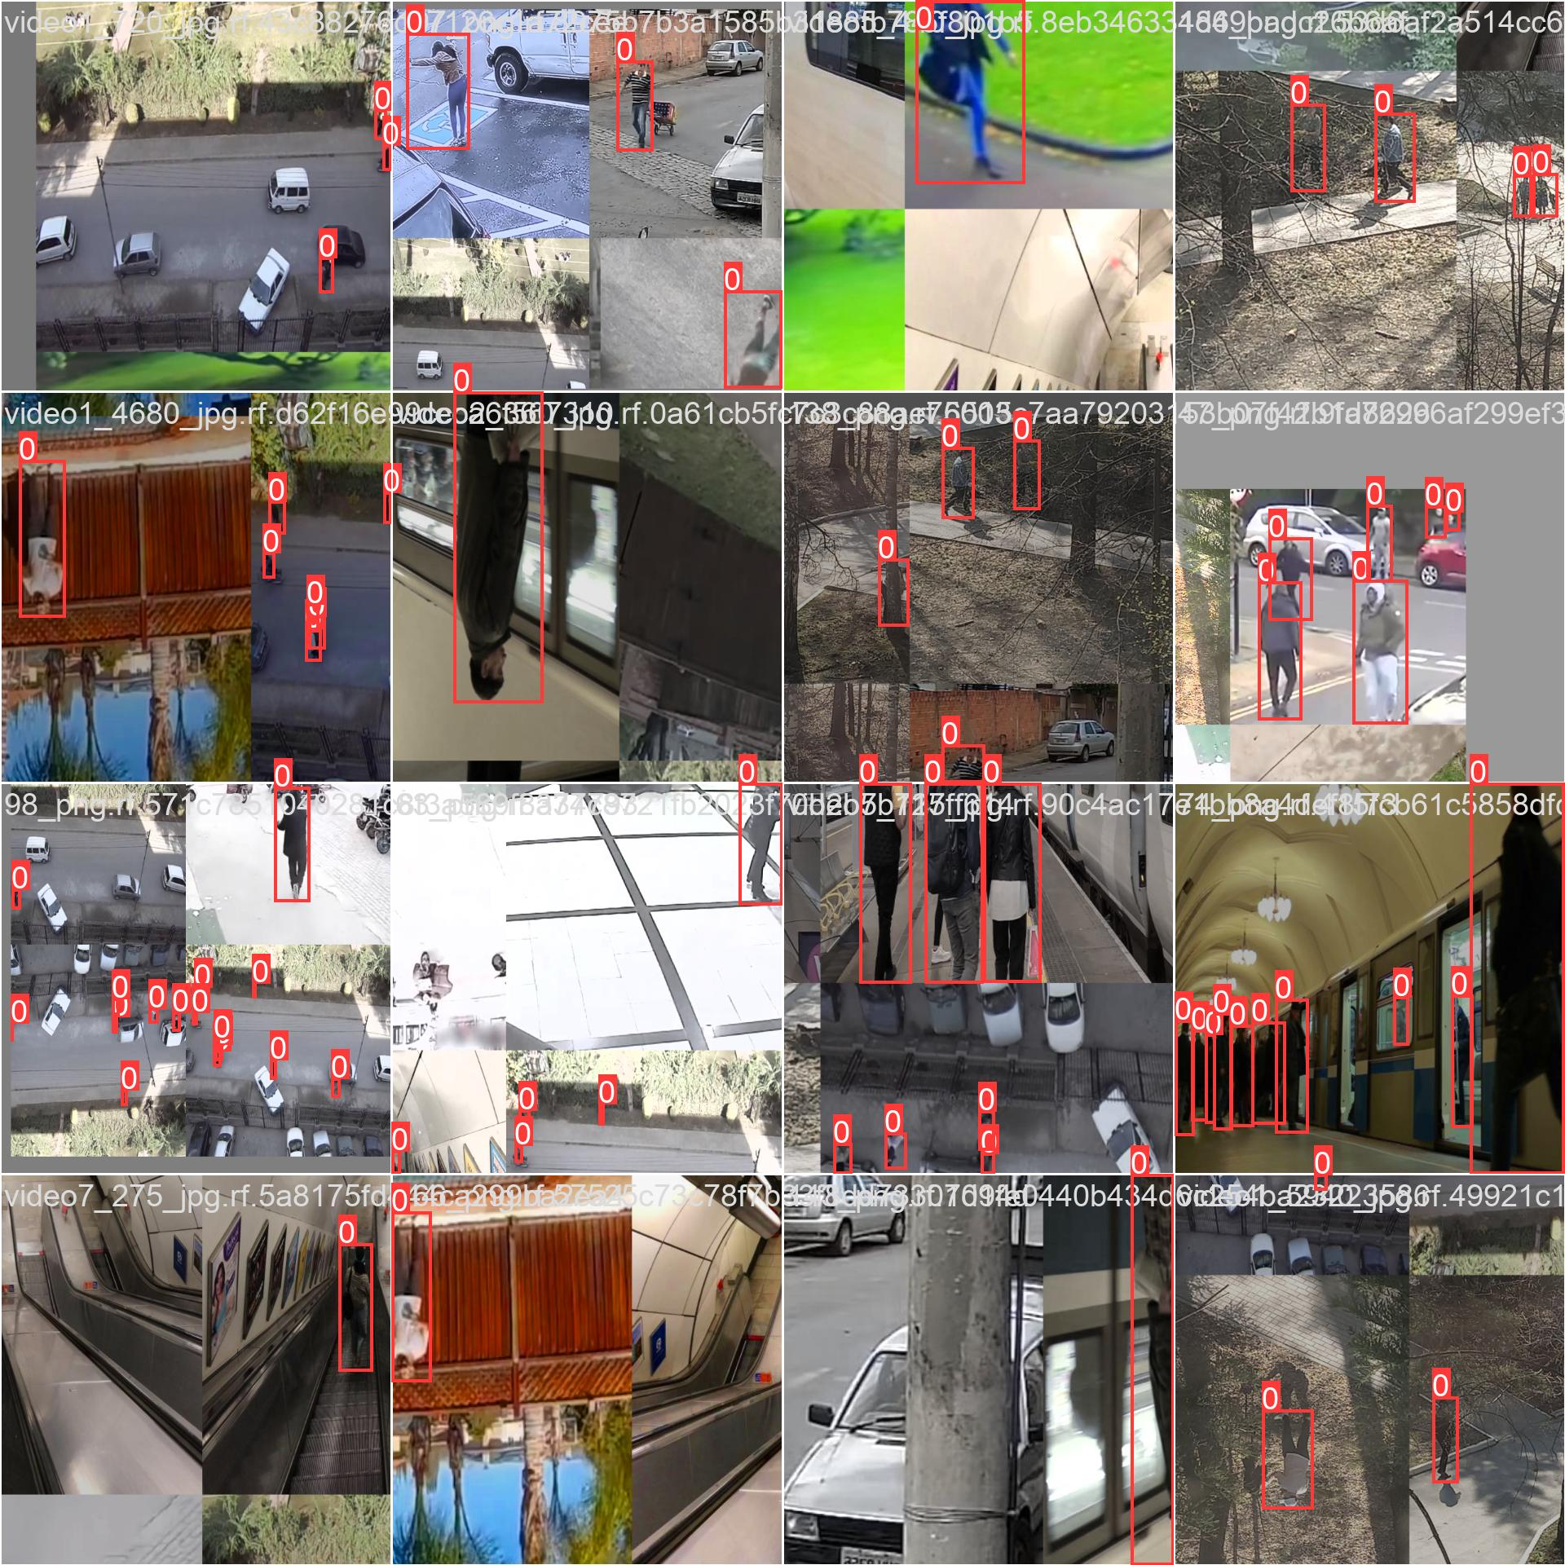
Train Batch

Slide 11
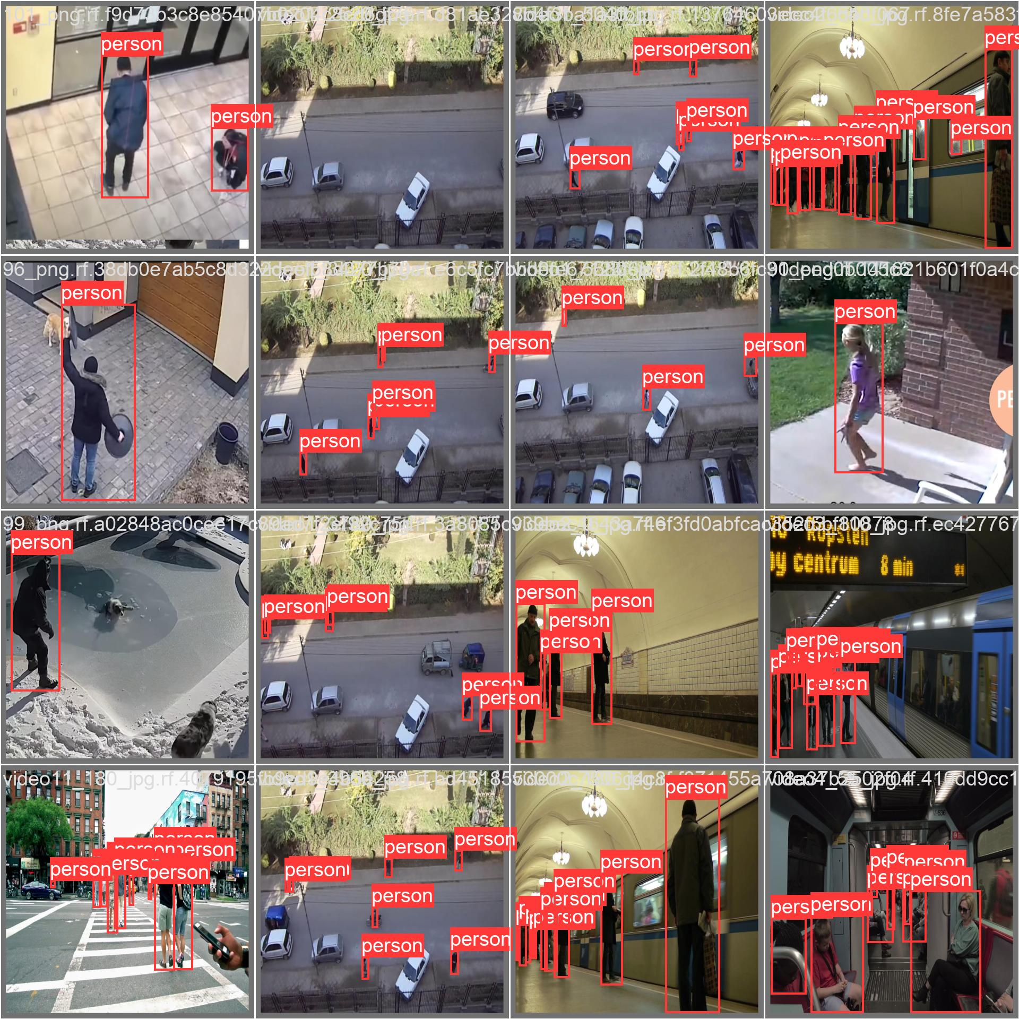
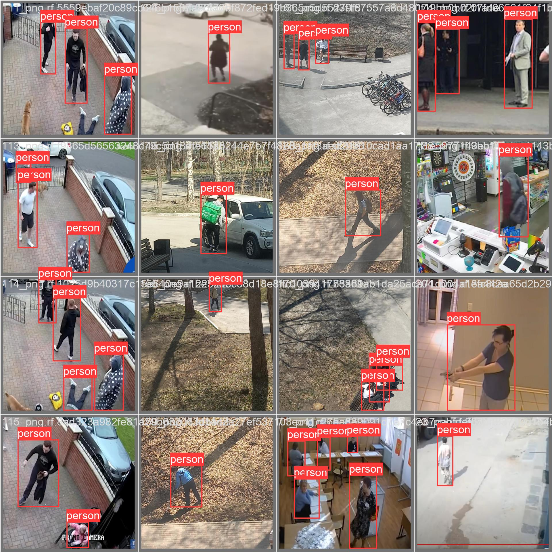
Validation Batch

Slide 12
Result :

Slide 13
Detection :
Utilizes a custom-trained YOLO model, best.pt, for object detection tasks.
Reads images from a specified directory and preprocesses them for input into the model.
Performs object detection using the YOLO model to identify objects within the images.
Applies post-processing techniques to the detected objects, such as drawing bounding boxes and labels.
Implements additional logic, such as fall detection, based on the characteristics of the detected objects.
Visualizes the results by annotating the images with bounding boxes, labels, and any additional information.
Saves the processed images with the annotations to a designated output directory.
Provides feedback or logging to indicate the successful processing and saving of the images.
Can be adapted and extended for various object detection tasks beyond fall detection.

Slide 14
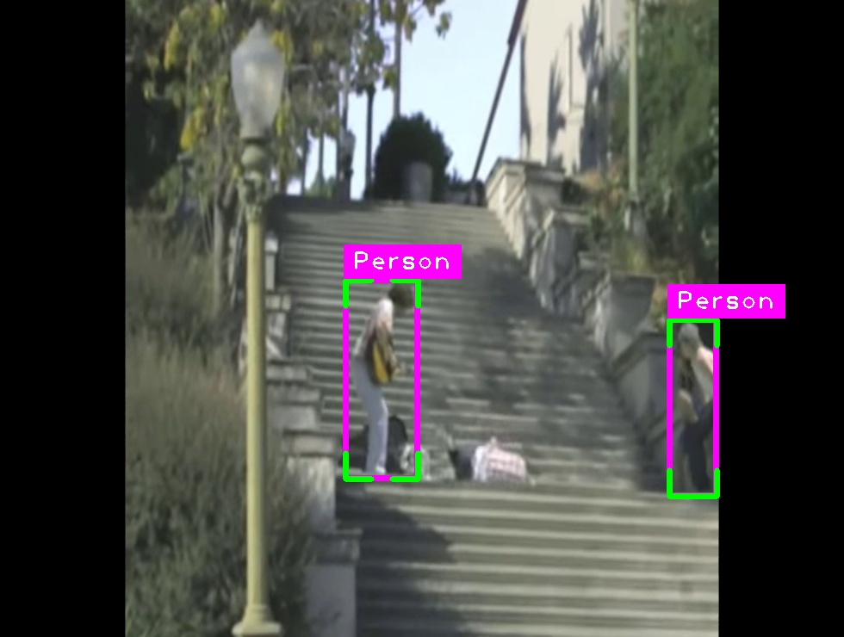
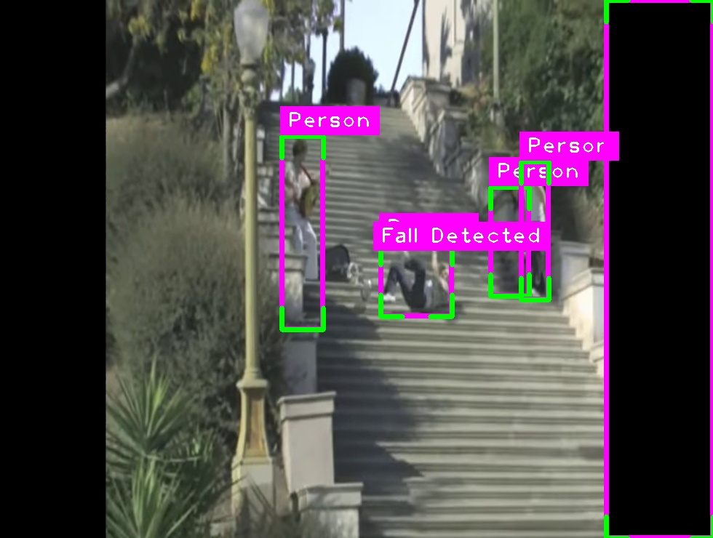
Test Batch

Slide 15
Post-processing :
Specifies the input folder containing the processed images and the output video file name.
Retrieves a list of processed image files from the input folder.
Sorts the image files based on the frame number extracted from the file names.
Reads the dimensions (height and width) of the first image to determine the video frame size.
Creates a VideoWriter object to write the images into a video file.
Iterates over each image file, reads the image, and writes it to the video.
Releases the VideoWriter object after all images are written to the video.

Slide 16
Challenges Faced :
Understanding the model and its parameters
Choosing between the models

Slide 17
Possible Approaches
Traditional Computer Vision Methods:
Utilize handcrafted features and classical machine learning algorithms like SVM or Random Forests for fall detection.
Extract features such as motion, shape, or texture from video frames and use them to train a classifier to distinguish falls from normal activities.
Pose Estimation Algorithms:
Employ pose estimation techniques to analyze the human body's posture and movements.
Detect unusual body configurations or sudden changes in posture indicative of a fall event.
YOLO CV Library:
Utilize the YOLO (You Only Look Once) computer vision library for real-time object detection.
Train a YOLO model to detect human subjects and classify their actions, including falls, based on bounding box predictions.

Slide 18
Possible Approaches
4. Open Source Models (OWL-ViT, OWL-V2):
Explore pre-trained models such as OWL-ViT (Vision Transformer) or OWL-V2 for fall detection.
Fine-tune these models on fall-related datasets to adapt them to specific detection tasks.
5. Zero Shot Object Detection Models:
Adopt Zero Shot Object Detection models for training, which excel at recognizing unseen classes during inference.
Leverage the capability of these models to detect falls without explicitly training on fall-related data, thereby reducing the need for extensive labeled datasets.
This is one good approach for fall detection.

Slide 19
Thank you

